Slide 1

Data Visualization with Tableau
Slides & data: brosz.ca/slides/tableau
Aug. 28, 2024
John Brosz, PhD
Data and Visualization Curator
Libraries & Cultural Resources
jdlbrosz@ucalgary.ca

Slide 2
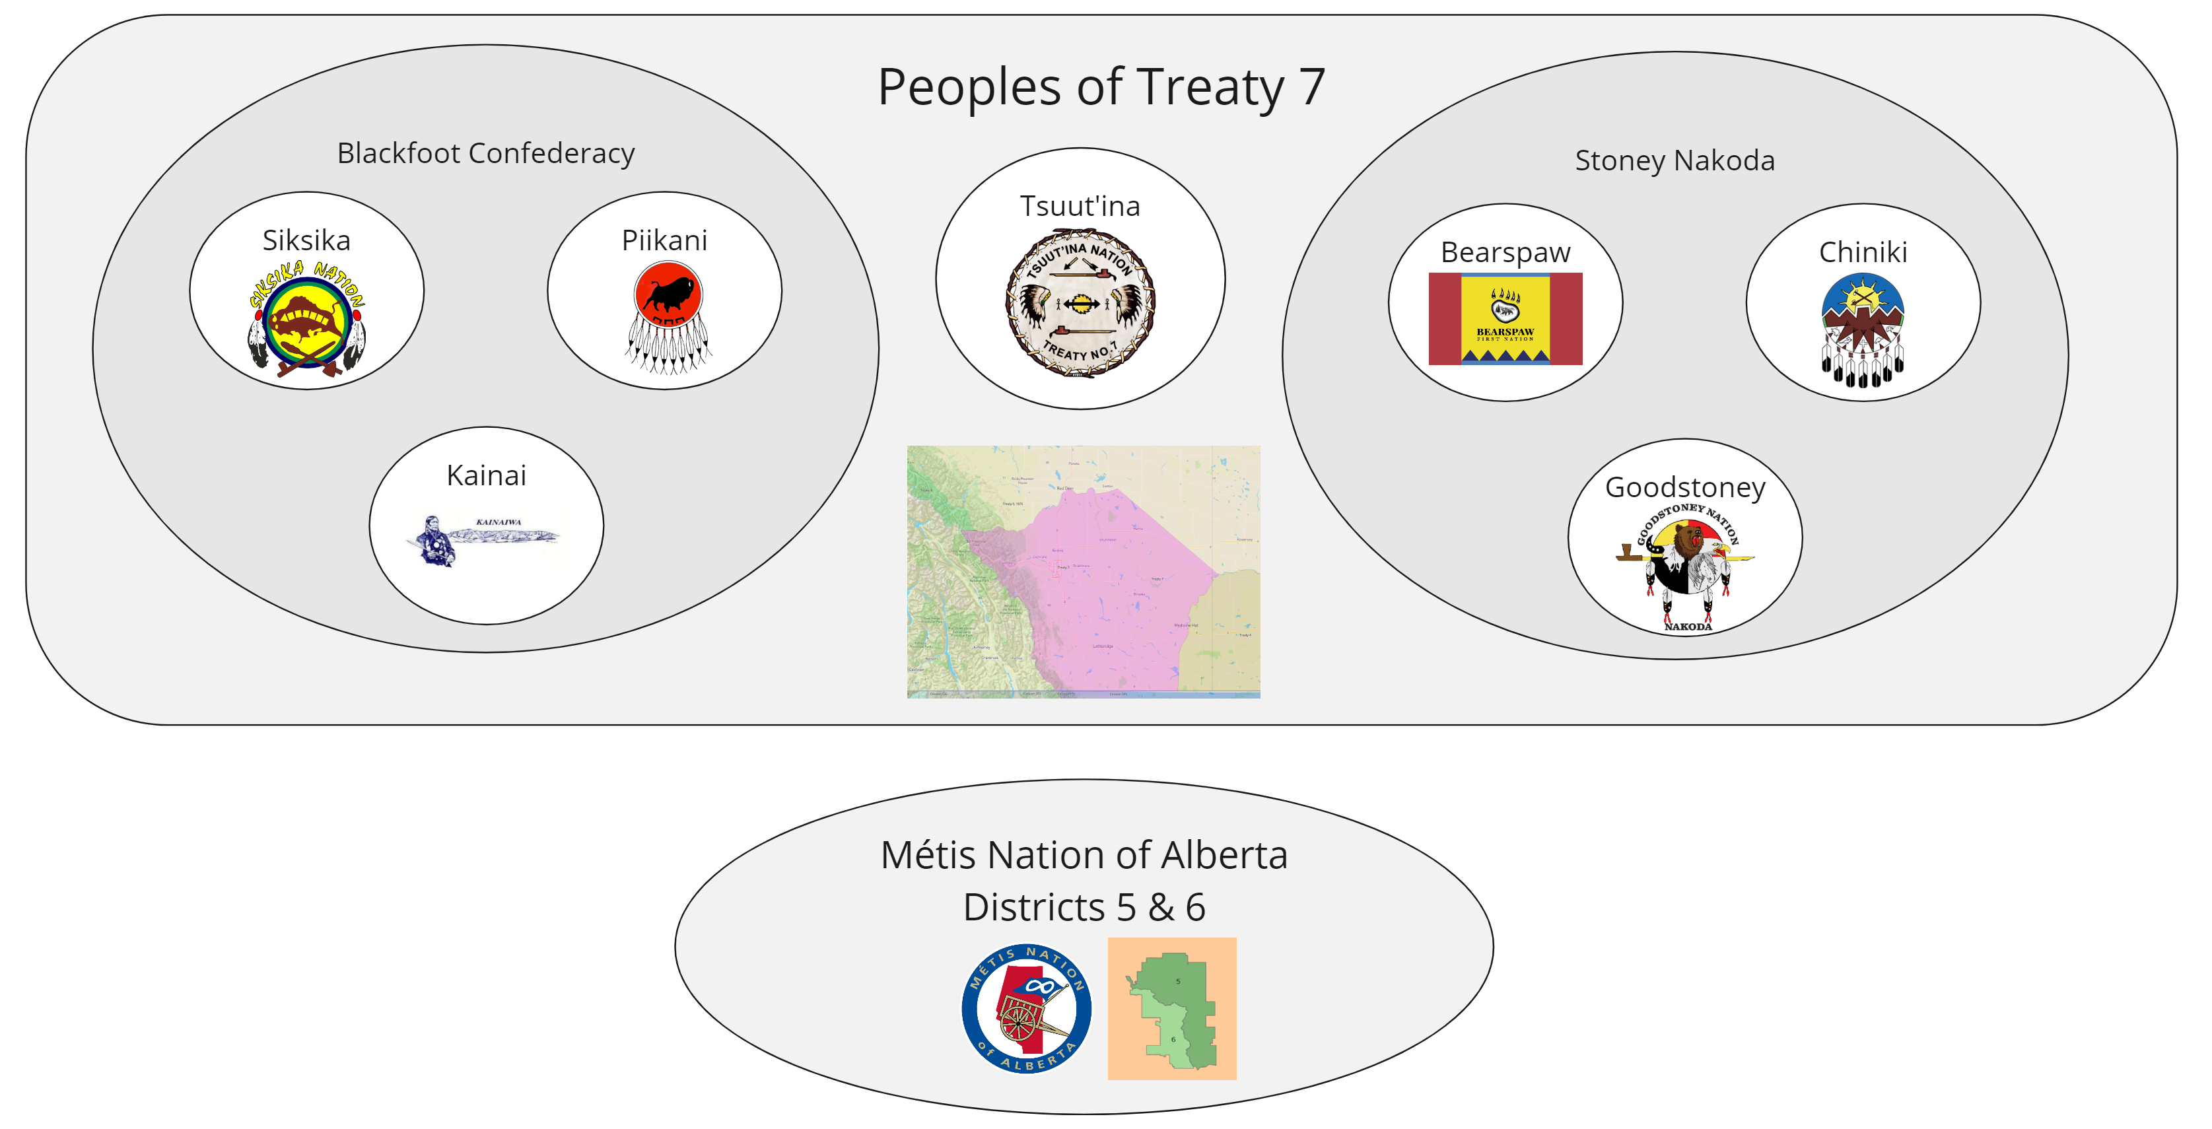
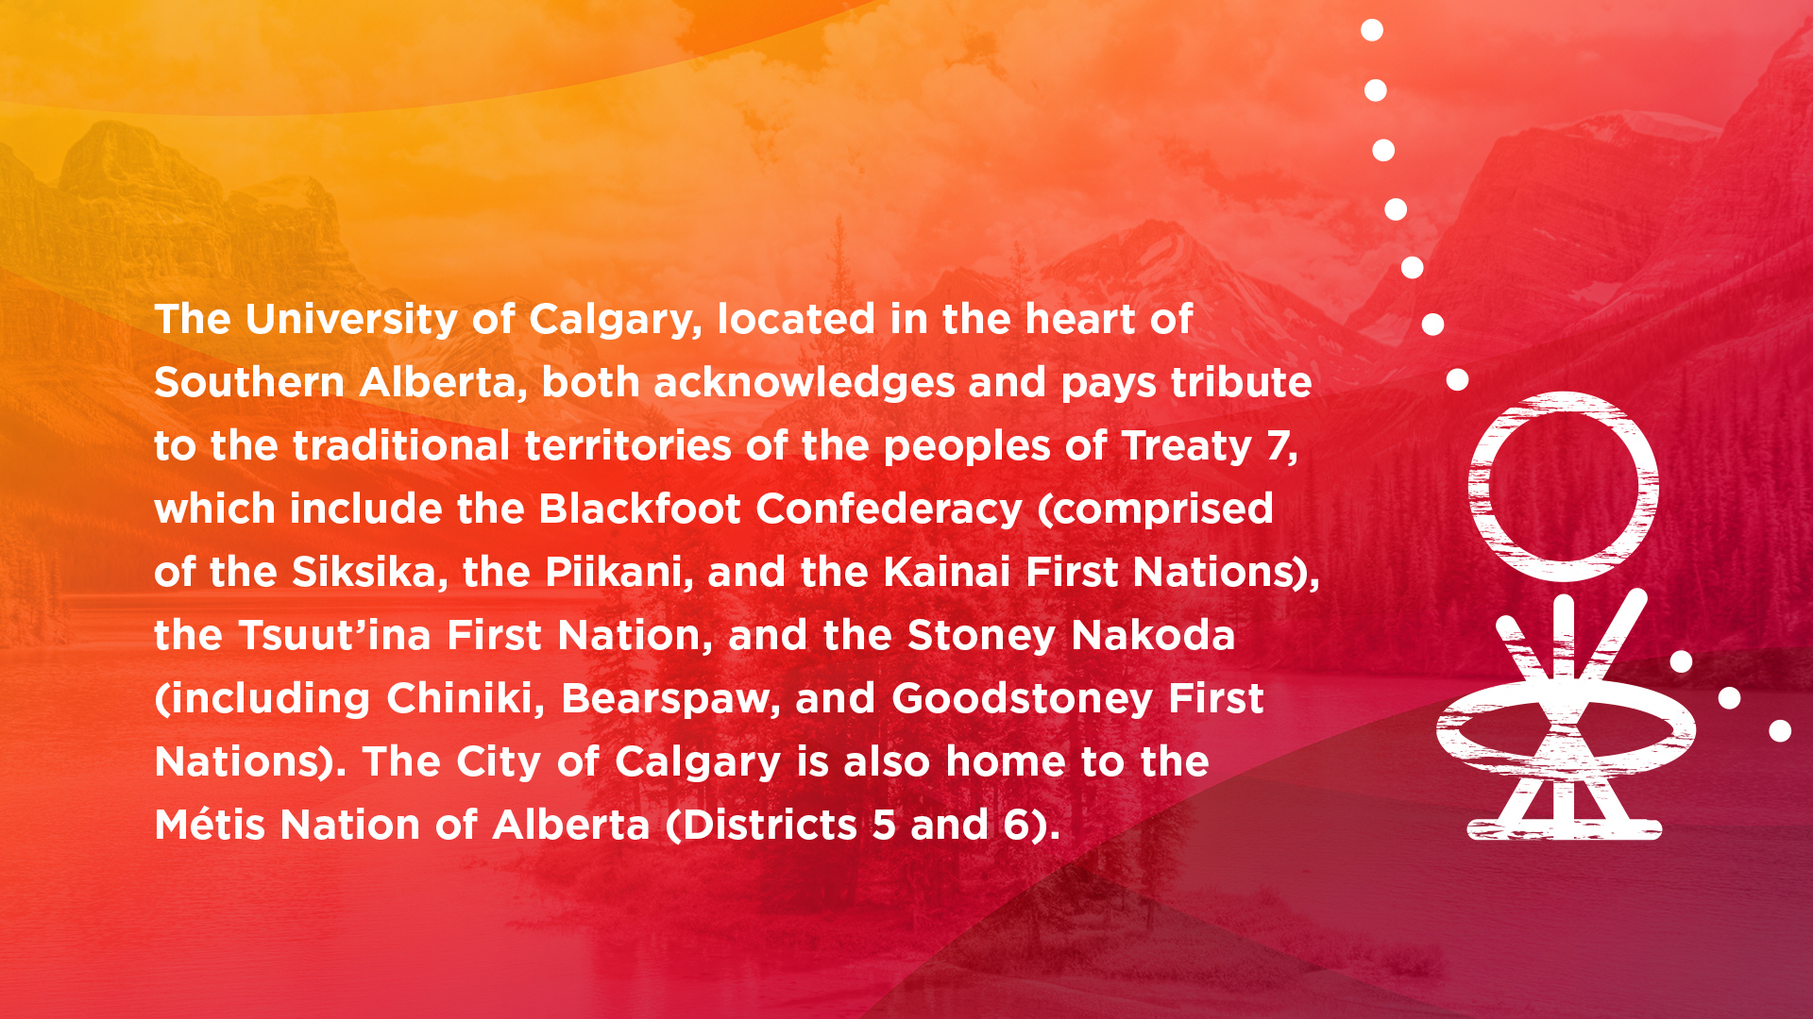
The University of Calgary, located in the heart of Southern Alberta, both acknowledges and pays tribute to the traditional territories of the peoples of Treaty 7, which includes the Blackfoot Confederacy (comprised of the Siksika, the Piikani, and the Kainai First Nations), the Tsuut’ina First Nation, and the Stoney Nakoda (including the Chiniki, Bearspaw, and Goodstoney First nations). The City of Calgary is also home to the Métis Nation of Alberta (Districts 5 and 6).

Slide 3
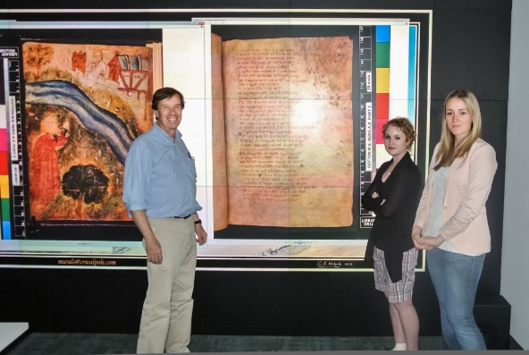
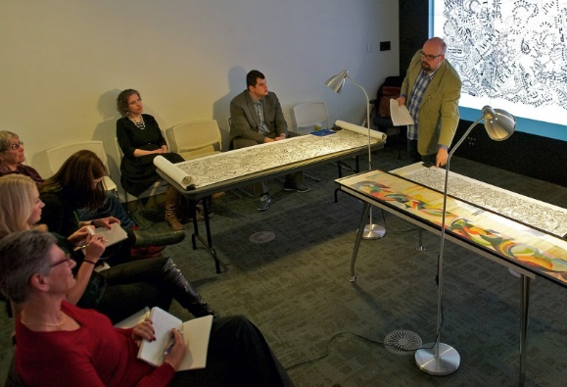

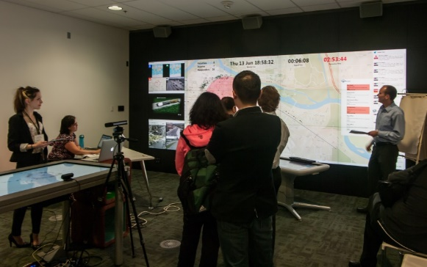
Visualization Studio
Uses:
Presentation
Analysis
TFDL 466B
Display Wall
  34.5 million pixels
  Compare that to HD
  (2.07 million) or even 4K
  (8.3 million)
  16’ (4.9m) wide and 6’ (1.8m) tall
Space to support research & learning
Free to book by faculty & grad students
Teaching
Events
https://library.ucalgary.ca/visualization

Slide 4

Goals
What is Tableau?
Importing Data
How to change chart types and operate Tableau
Interactive visualization
Exporting your visualization
Slides & data: brosz.ca/slides/tableau

Slide 5
1. What is Tableau?
Developed out of Stanford student’s PhD project
Designed for exploration of large multi-dimensional datasets
Pick the data you are interested in,
then explore to find the best chart type
When Excel just isn’t enough . . .
Alternatives: PowerBI, QlikView
Slides & data: brosz.ca/slides/tableau

Slide 6

Tableau Versions
Desktop (Mac & Windows)
Runs on Windows/Mac
Can publish results to Tableau’s website
Online
Cloud version
Public (free)
Free, all data hosted publically (everything online)
10 GB of space for data
Prep
Data wrangling
Reader
Free, View & interact with Tableau worksheets
Server
Can publish results to web & restrict access
Slides & data: brosz.ca/slides/tableau

Slide 7


Academic/Student Program
Available for free to post-secondary students.
http://www.tableau.com/academic/

Slide 8
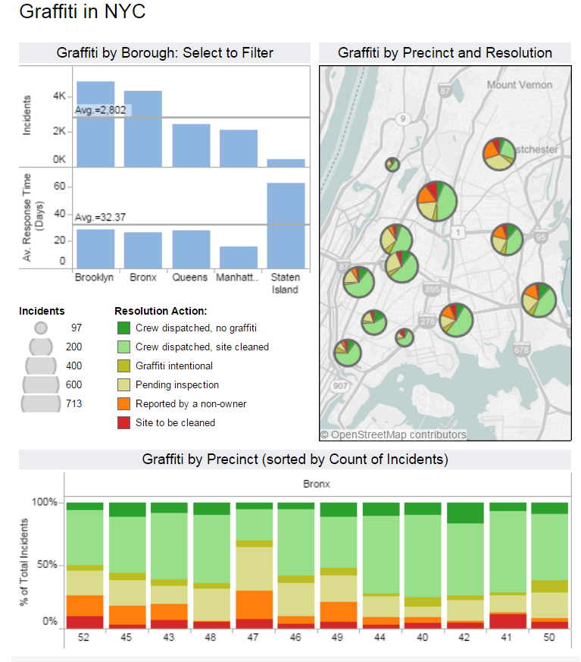
https://https://public.tableau.com/en-us/s/gallery/new-york-city-graffiti
Notes:
https://public.tableau.com/en-us/s/gallery/new-york-city-graffiti

Slide 9
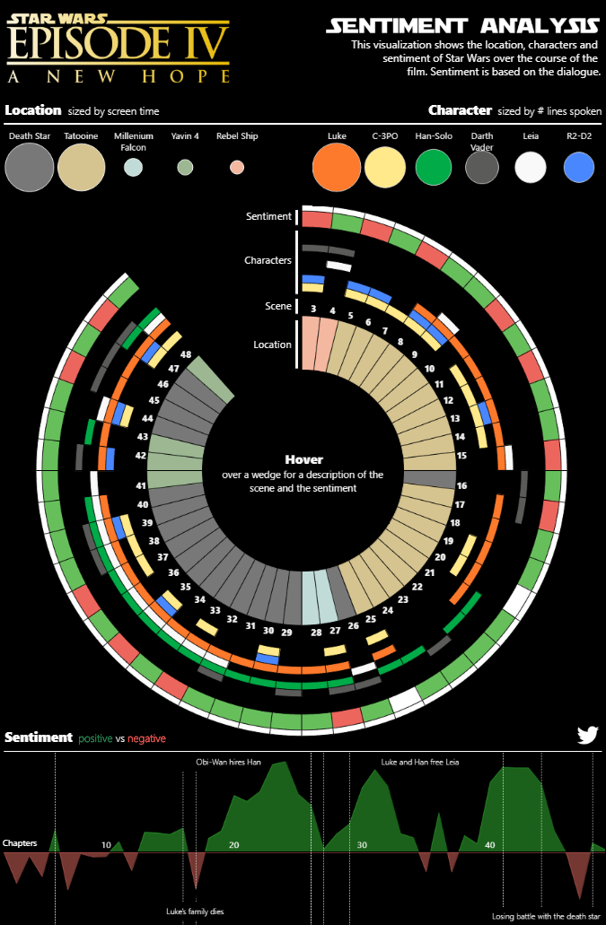
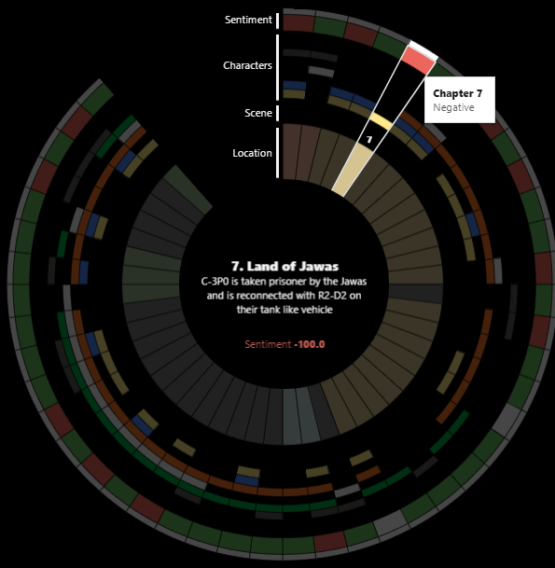
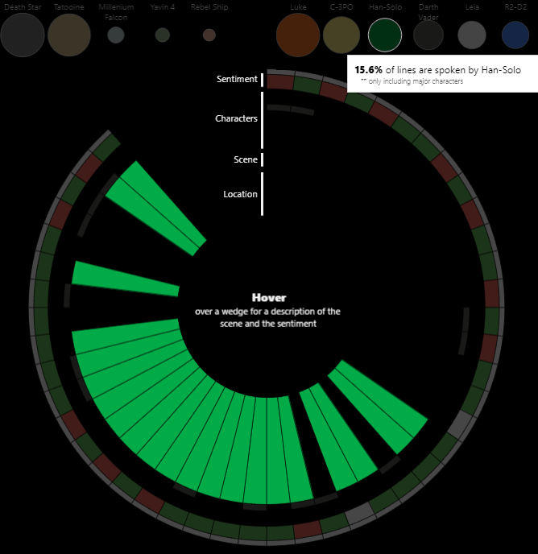
https://public.tableau.com/en-us/s/gallery/star-wars-sentiment-analysis
Notes:
https://public.tableau.com/en-us/s/gallery/star-wars-sentiment-analysis

Slide 10
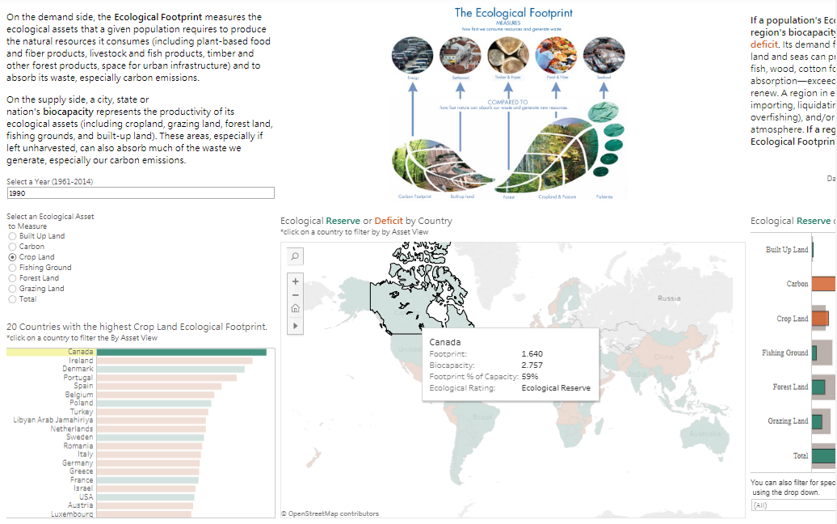
https://public.tableau.com/en-us/s/gallery/ecological-footprint
Notes:
https://public.tableau.com/en-us/s/gallery/ecological-footprint

Slide 11
2. Tableau & Data
File (excel, csv)
Database (Access, Oracle, MySQL)
Online Sources (Google Analytics, Amazon Redshift)
Get data files at brosz.ca/slides/tableau
  calgweather.csv
  (right click & “save link as…”)
Notes:
- Show how to load weather data file

Slide 12
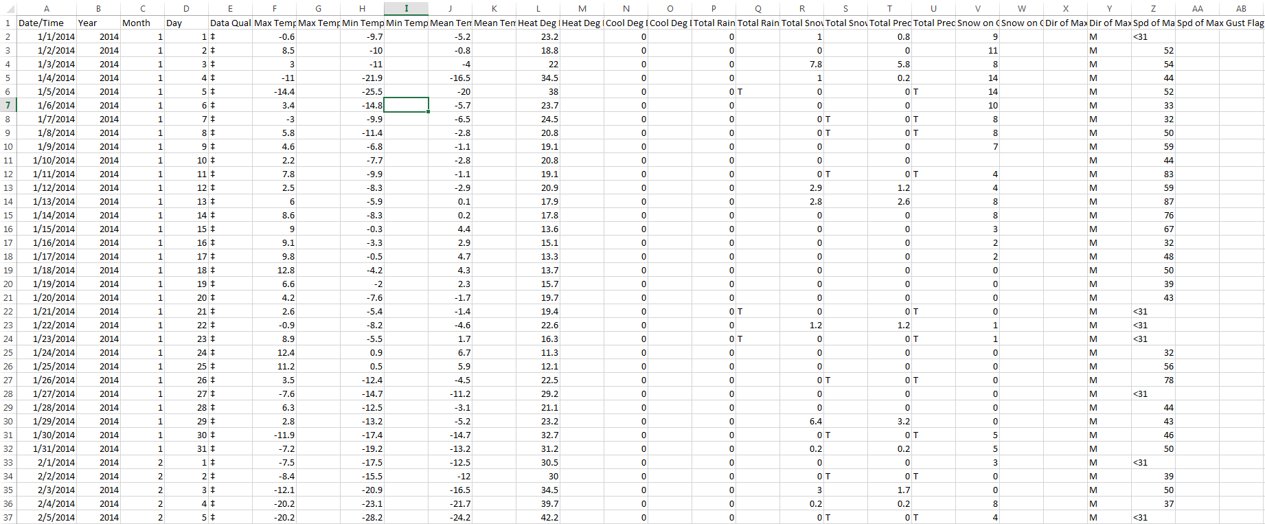
Data

Slide 13
Data

Slide 14
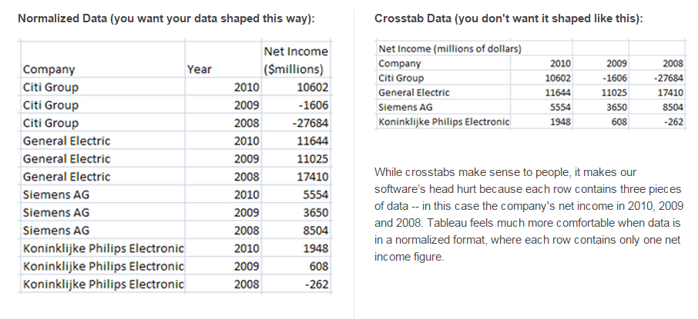
Normalized Data

Slide 15
Data Types
Numbers
Text
Dates
Times
Geography (attempts to automatically recognize)
  Latitude & Longitude
  Country
  City
  Phone area codes
  Postal codes (first three digits)

Slide 16
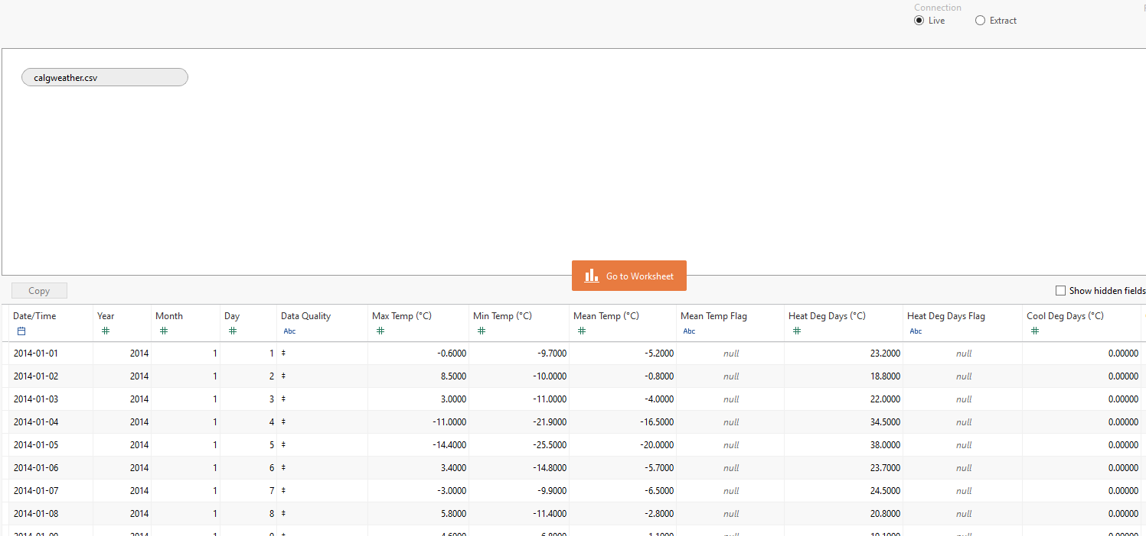
Data

Slide 17
Data

Slide 18
Data

Slide 19
Follow Along Demo
Make line chart with Calgary weather data here; Max Temp and Date.
Start by pointing out how Tableau has aggregated the data
Highlight how to move from years to day-by-day
Move to a dual axis line chart by adding Min Temp. Show how to synchronize axes.

Slide 20
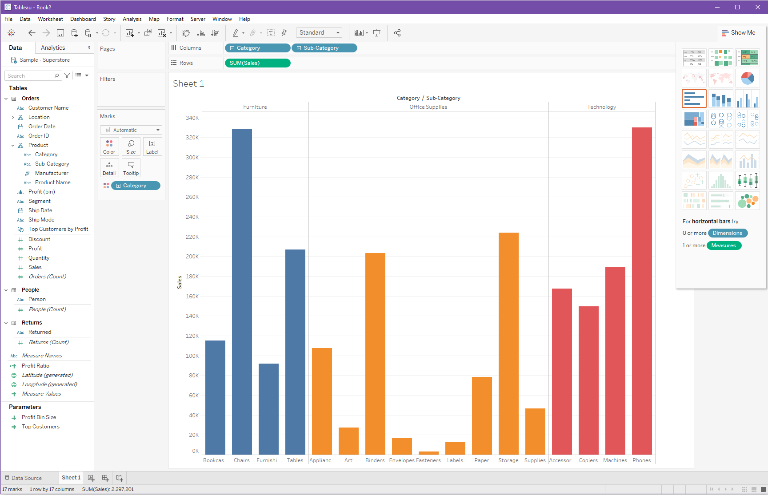
Datasets
Pages
Pills / Rows & Columns
Filters
Show Me
Menu
(can change
position)
Marks
Tables &
Columns
Parameters

Slide 21
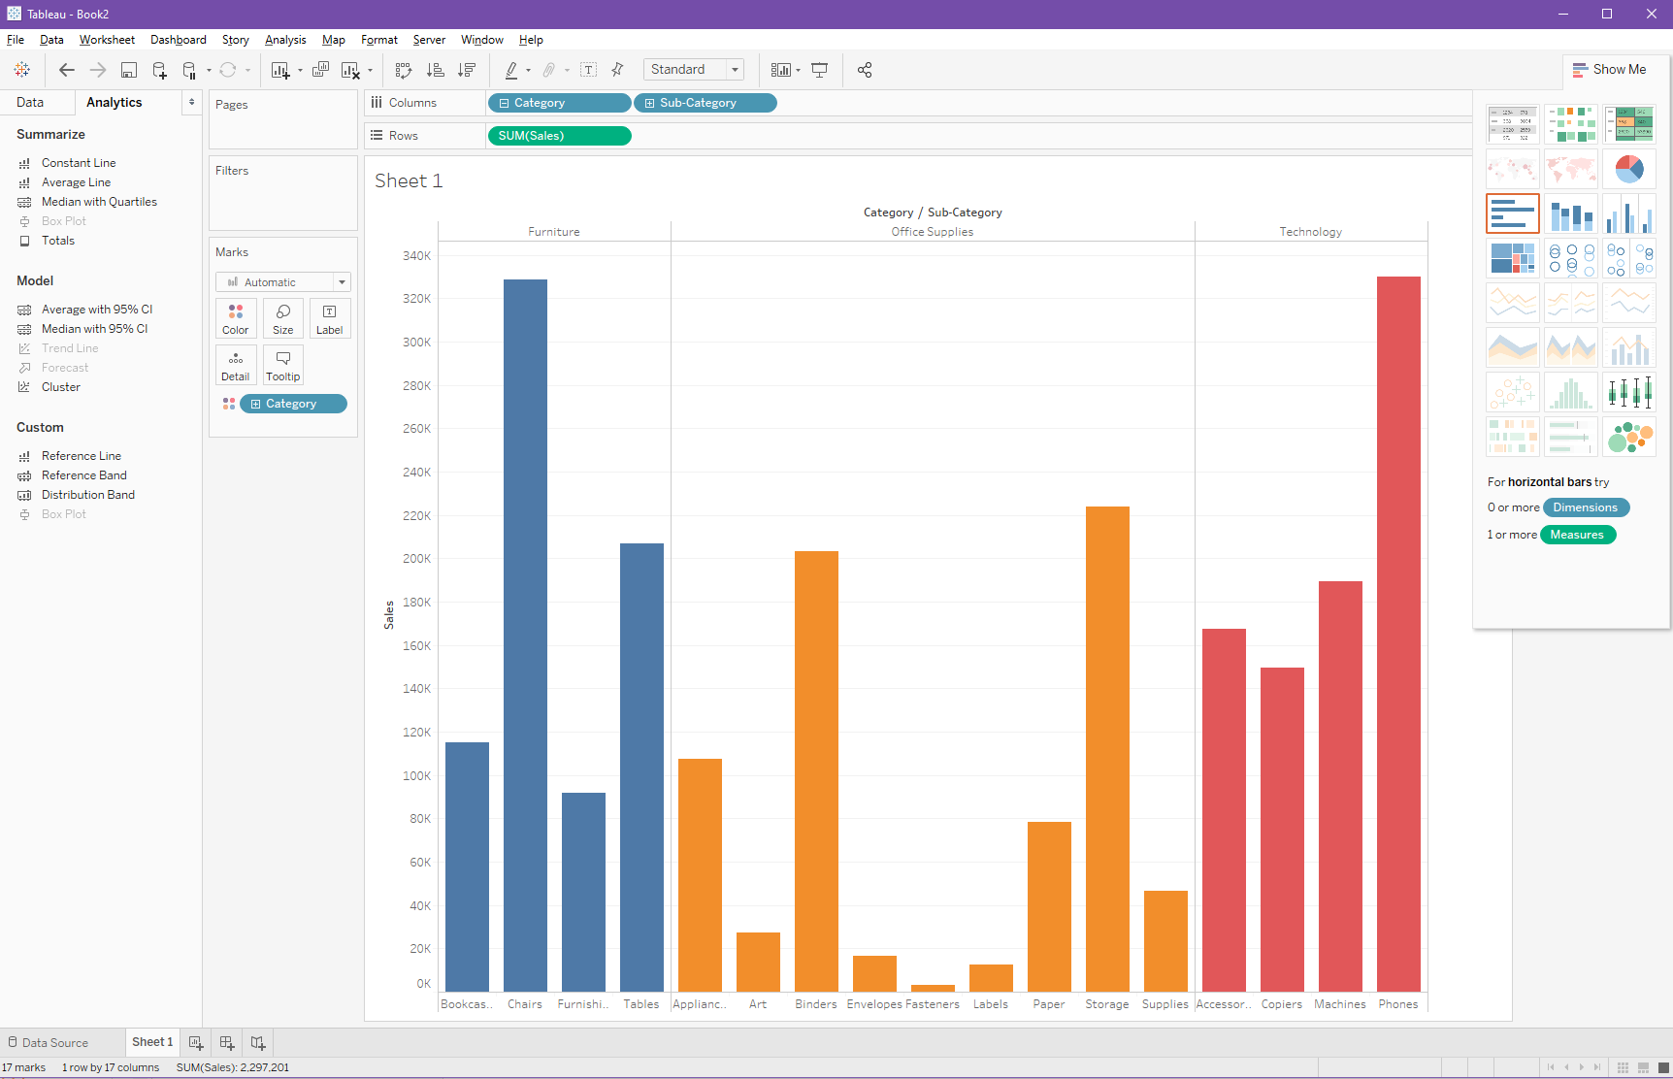
Sorting Order
Slideshow Mode
Swap Rows & Columns
Analytics

Slide 22
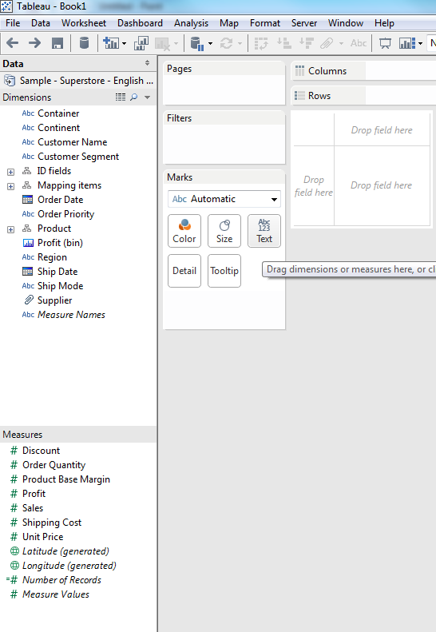
Dimensions:
  These are items that we might want to categorize our data by.
Measures:
  The numbers & metrics that we want to analyze.

Slide 23

Worksheet
  A single visualization. Drag data to rows and columns to get started
Dashboard
  A display created by combining one or more worksheets
Story
  A sequence of worksheets to tell a story

Slide 24
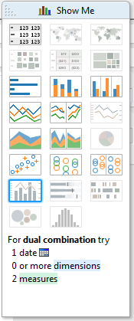
Pick a Visualization
Show Me Window
Highlights valid alternatives
Also can Ctrl-click dimensions & measures to get “Show Me” alternatives
Notes:
Superstore
Close -> Saved data sources
- Sample – Superstore – English (extract)
BAR CHART
Sales as Rows
Product Category as Columns
Product Department as Another Column
Replace Sub-Category with Product Region
Drag Product Region to Colour
Name Sheet Bar Chart

Slide 25
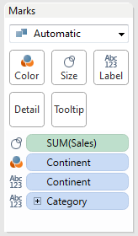
Marks
Map measure/dimension to different type of visual variable
  Color/shade (when categorical vs ordered)
  Size
  Label
  Detail
  Tooltip
Click to customize each element
Notes:
Duplicate Sheet and then try things on the Show Me panel.
Go to Tree Map
TREE MAP
Note that size and colour are both sales.
Labels display the Category and Region
Now let’s look at profit . . . Drag profit to colour
Edit the colour
Back
Add Sales label
FILLED WORLD MAP
Now try dragging Measures->Supplier to Colour
Or try dragging Region to Colour
Then also drag Region to Label
Try Excluding
Try Back & Forward Arrows
Now lets create a map:
Create another sheet
Holding the control key select Mapping items->Country/Region and Profit
Then on the Show Me panel pick the filled map
Now let’s introduce a point for interaction with a filter
Right click the product category dimension and select show quick filter
On the right side we can now look at profit for different categories of item & the map updates to show the correct measures
SCATTERPLOT
Another new sheet
Profit vs Sales
Region to Colour
Category to Shape
Right now everything is summarized to Category/Region . . . We can get down to customers by dragging customer name to detail
Then add profit to label
Lastly, let’s try a trend line, right click and trend line

Slide 26
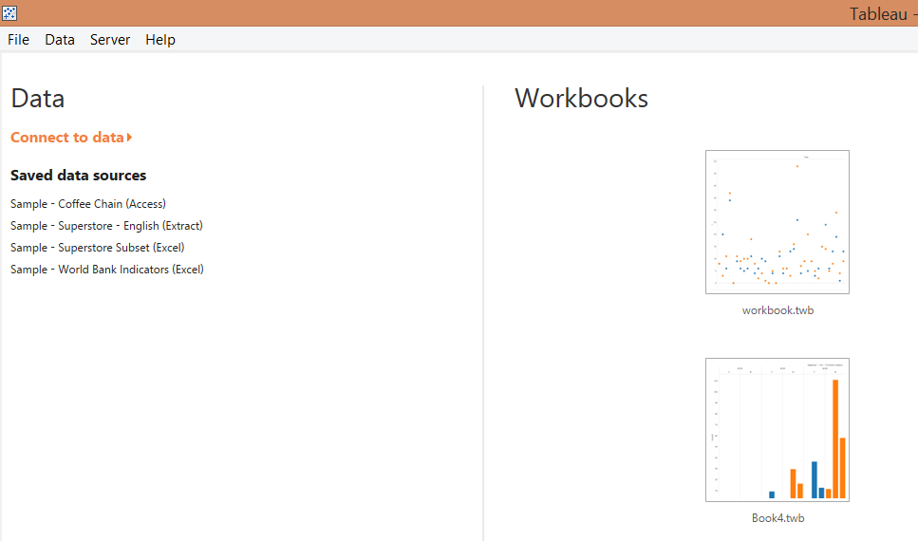
Visualizations

Slide 27
Follow Along Demo
Bar Chart
  Category & Sales
  Add subcategory
  Color by category
  Color by profit
Treemap
  Start by encouraging everyone to explore different chart types with the show me menu
  Then move to the treemap entry
  Add more labels
  Highlight how pills appear in the marks menu to show you how size, color, labels, etc are being used.

Slide 28
Fellow Along Demo
Map
  Use state/province and sales
  Selected the filled map
  Again add labels for state names
  Add an interactive filter for subcategory
    Show how to change the filter widget to dropdown, radio buttons, etc
Scatterplot
  Sales and profits
  Point out aggregation again
  Show how detail entry in marks works to break up the aggregation
  Adjust colors, shapes, etc.
Dashboard
  Quickly throw all the previous examples onto one dashboard
  Show how to get filter widget to apply to all worksheets
  Show how to use “funnel” button to make worksheets into interactive filters for the rest of the dashboard

Slide 29
Visualizations make sure we covered all of these items
Drag & drop
  Order Date (columns) & # of Records (rows)
See your data (details & table)
Tableau likes to add things up
Menus / little triangles
Forward / back buttons
Break down dates

Slide 30
Output
PDF / Powerpoint / Image
Tableau workbook (can be read in Tableau Reader)
Create an interactive webpage
  Public
  Server license

Slide 31
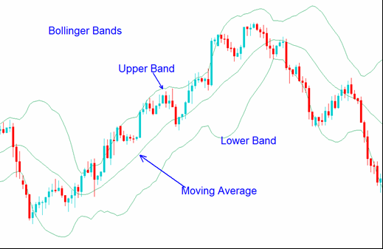
Calculated Field:
Bollinger Bands
Data: http://brosz.ca/slides/tableau/apple%20stock.csv

Slide 32
Bollinger Bands
Add data file (Apple)
[Adj Close] for the rows
[Date] for the columns
Create moving average calculated field for the “center” line
window_avg(avg([Close]),-[Period],0)
Use the moving average of the standard deviation calculated field to create “upper” and “lower” lines
window_stdev(avg([Close]),-[Period],0)
Notes:
http://www.tableausoftware.com/learn/tutorials/on-demand/bollinger-bands?signin=962a7c787ea7b4de028b50badd708c94

Slide 33
More Info
Training Videos
http://www.tableau.com/learn/training
https://www.linkedin.com/learning/
(free month, also available through Calgary Public Library)
Tableau Visualization of the Day
http://www.tableau.com/public/community/ viz-of-the-day
Notes:
Does tableau seem useful?
Is there more you’d like to see?
Are these examples all lame?

Slide 34
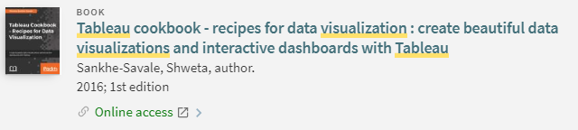

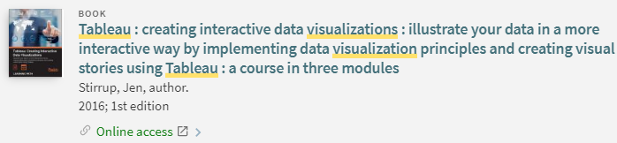

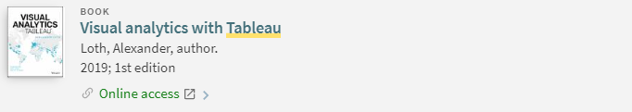
LIBRARY.UCALGARY.CA – search for TABLEAU VISUALIZATION

Slide 35
Questions
Slides & data: brosz.ca/slides/tableau
John Brosz, PhD
Data and Visualization Curator
jdlbrosz@ucalgary.ca

